Slide 1
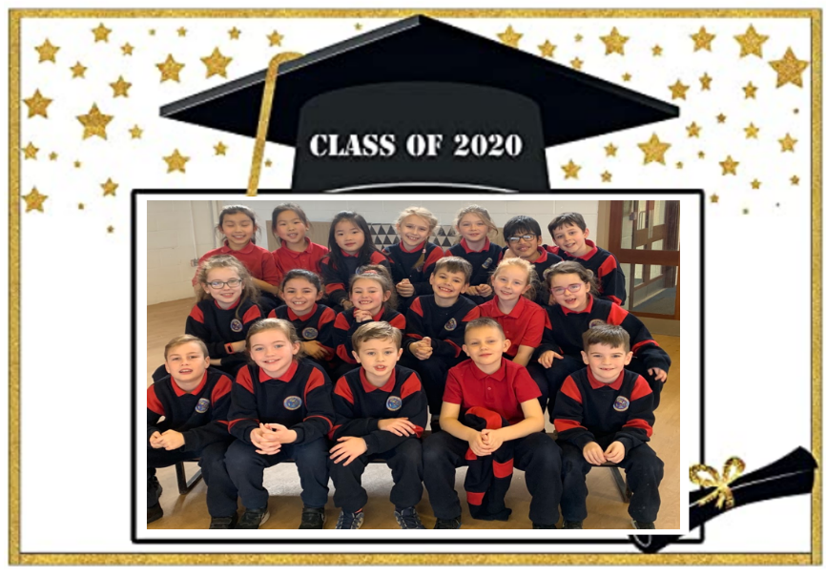
2nd Class Graduation

Slide 25
